Slide 1
Hospital Billing 101
An introduction and recap of Hospital Billing guidelines

Slide 2


Revenue
Cycle
Flow
Physician Order
Orders for service requested
Scheduling
Services requested via orders are scheduled
Pre-Registration / Registration
Demographic verification and consents
Insurance Verification
Verify coverage and authorization, secure source of payment
Patient Care / Services Rendered
Necessary care is provided to the patient
Charge Capture
Charges added for all services rendered and documented
Coding
Procedures and diagnoses for the care are coded as documented
Discharge
Case management plans patient discharge and documents disposition
Billing
UB04 and CMS 1500 claims are generated
Scrub and Corrections
Claims are scrubbed for appropriateness and corrections are made
Payment Posting
Insurance payments and contractuals posted
Follow-up and Denials
Follow-up of outstanding accounts. Denials are reviewed and worked
Patient Billing and Collections
Patient portions are billed and followed for payment

Slide 3
Claims Forms
UB-04 – implemented for institutional billing on March 1, 2007 and mandated by CMS as of May 23, 2007. Used for facilities such as hospitals, skilled nursing facilities, hospices, home care, and others in an institutional setting.
Updated form met regulations for HIPAA (Health Insurance Portability and Accountability Act).
Governed by the National Uniform Billing Committee (NUBC) that was formed in 1975 by the American Hospital Association.
The National Uniform Billing Committee (NUBC) is responsible for the design and printing of the UB-04 form. The NUBC is a voluntary, multidisciplinary committee that develops data elements for claims and claim-related transactions, and is composed of all major national provider and payer organizations (including Medicare).
The 837 Institutional electronic claim format is the electronic version of the form and is in use by providers who submit claims electronically.

Slide 4
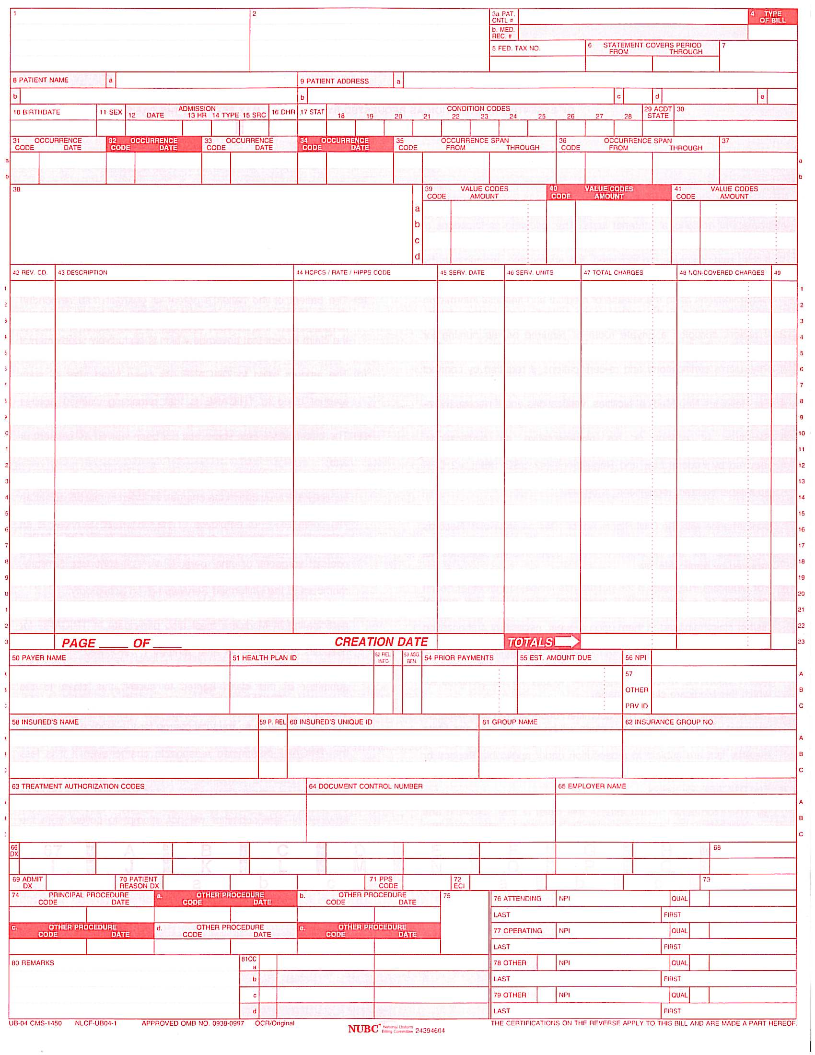
Claims Forms (cont.)
Sample of Current UB-04

Slide 5
Claims Forms (cont.)
CMS 1500 - Formerly known as HCFA 1500
CMS-1500 Form was modified to include split provider identifier fields to accommodate National Provider Identifier (NPI)
Implemented January 1, 2007 – New Form revision number 02/12
Effective April 1, 2014, any paper claim, including resubmissions or corrections, must be submitted on the 02/12 version of the CMS-1500
Used to bill professional caregiver charges for payment

Slide 6

Claims Forms (cont.)
CMS 1500 form sample

Slide 7

Common Denials
A few of the common institutional claims denial reasons are outlined below:
  Insurance Eligibility – soft denial that in many cases can be corrected and reimbursement rendered
  Authorization not Obtained – mainly stands as a hard denial if steps are not taken prior to the date of services rendered to obtain approval by the insurance carrier to render ordered services. Can be appealed and may be overturned in some situations
  Medical Necessity – soft denial that is appealable as long as there is sufficient documentation to support the necessity for the services rendered. This also extends to appropriate level of care denials based on medical necessity and the clinical documentation to support the level billed
    ABN forms (Advanced Beneficiary Notice) may be a deciding factor on provider or patient responsibility with certain medical necessity denials

Slide 8

Importance of Revenue Cycle
All areas of the Revenue Cycle are needed to support payment of medical claims. This payment ensures the overall financial viability of the healthcare organization.
Objectives of the Revenue Cycle:
Reduce Outstanding Accounts Receivable Days
Reduce Bad Debt Write Offs
Reduce Denials
Improve Cash Flow
Increase Revenue
Maintain Patient Satisfaction

Slide 9
Breakdowns
Accounts Receivable Days – Gross days in total receivables outstanding based on average daily revenue.
  Example: total AR outstanding $300,000 divided by average daily revenue of $25,000 – AR Days = 12 days in total AR outstanding
  Gives you a picture of the average number of days that it takes for a receivable to be collected on.
Bad Debt Expense – amount of total charges that are being adjusted off as uncollectible.
Contractual Allowance (or Adjustment) – the agreed upon discounted contractual amount that is not collectible money from the insurance or patient.
Increasing Revenue – collaborative across multiple departments within the organization to ensure accurate charge capture and documentation of services rendered. These areas must be perfected to ensure that the services provided are billed for and reimbursed appropriately.

Slide 10
Bad Debt Reduction
Reducing the amount of billed charges that are written off as uncollectible.
Patients often present to healthcare facilities without insurance or a means to pay for their treatment. Part of the Bad Debt Reductions efforts are screening and assisting patients with options for covering their bills. Some of those options include:
  Screening for and securing Medicaid coverage for patients that quality:
    MAF – Medicaid for Families and Children
    MAD – Medicaid for the Aged or Disabled
    Medicaid provides health care coverage for low-income individuals and families who can't afford health care costs. Medicaid serves low-income parents, children, seniors and people with disabilities. Medicaid is governed by both federal and state laws.
  Reviewing and assisting with Health Insurance Marketplace coverage
  Reviewing Financial Assistance and Charity Care guidelines to aid with patient debt and community benefit
    Changes to the Financial Assistance programs for non-profit facilities were enacted with 501r in January 2016.

Slide 11
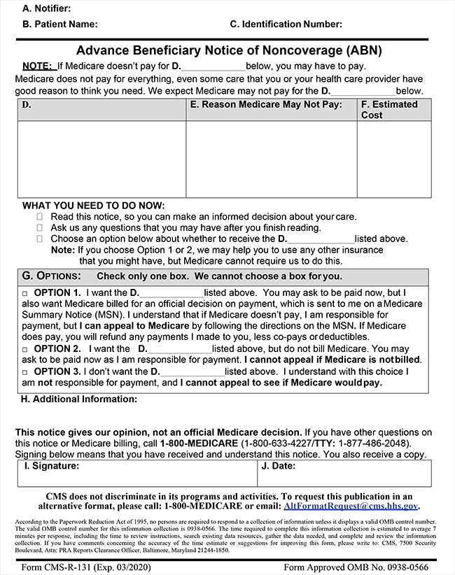
ABN Notice
Advance Beneficiary Notice – used when a physician orders a procedure or services that Medicare may not cover based on medical necessity or frequency of the service.
Patient is informed in advance that the service is not likely to be covered by Medicare and that they will be responsible for payment.
The patient must select one of three options on the form.
For the patient to be held liable for the non-covered charges, the option for them to accept the charges must be selected and the form must be signed and dated by the patient.
Blanket ABN forms are not allowed and must specifically outline the service and reason for possible non-coverage.

Slide 12
Insurance Carriers
CMS – Centers for Medicare and Medicaid Services
The Centers for Medicare & Medicaid Services, CMS, is part of the Department of Health and Human Services (HHS).
On July 30, 1965, President Lyndon B. Johnson signed into law the bill that led to the Medicare and Medicaid. The original Medicare program included Part A (Hospital Insurance) and Part B (Medical Insurance). Today these 2 parts are called “Original Medicare.” Over the years, Congress has made changes to Medicare:
  More people have become eligible.
For example, in 1972, Medicare was expanded to cover the disabled, people with end-stage renal disease (ESRD) requiring dialysis or kidney transplant, and people 65 or older that select Medicare coverage.
  More benefits, like prescription drug coverage, have been offered.
At first, Medicaid gave medical insurance to people getting cash assistance. Today, a much larger group is covered:
  Low-income families
  Pregnant women
  People of all ages with disabilities
  People who need long-term care
States can tailor their Medicaid programs to best serve the people in their state, so there’s a wide variation in the services offered. Medicaid is a joint venture of Federal and State funding and governance.

Slide 13

Insurance Carriers
MCOs – Managed Care Organizations - Carriers have contracts with health care providers and medical facilities to provide care for members at reduced costs. The carriers make up the plan's network and how much of your care the plan will pay for depends on the network's rules.
Plans that restrict your choices usually cost you less. If you want a flexible plan, it will probably cost more. There are three types of managed care plans:
  Health Maintenance Organizations (HMO) usually only pay for care within the network. You choose a primary care doctor who coordinates most of your care.
    Members pay a fixed annual premium in return for health care access that is limited to the HMO’s network of physicians and hospitals.
  Preferred Provider Organizations (PPO) usually pay more if you get care within the network. They still pay part of the cost if you go outside the network, but the patient liability is higher.
    In a PPO, the managing entity is not always the insurer; it also may be an employer or a plan administrator. Discounted rates are negotiated with specific health care providers in return for increased patient volume. However, members may choose providers outside of the PPO network, but they will have to pay more to do so.
  Point of Service (POS) plans let you choose between an HMO or a PPO each time you need care. POS plans typically cost more, as there is a higher level of flexibility in physician choice.

Slide 14
Medicare Programs
Part A - (Hospital Insurance) covers most medically necessary hospital, skilled nursing facility, home health, and hospice care. It is free if you have worked and paid Social Security taxes for at least 40 calendar quarters (10 years); you will pay a monthly premium if you have worked and paid taxes for less time.
Part B - (Medical Insurance) covers most medically necessary doctors’ services, preventive care, durable medical equipment, hospital outpatient services, laboratory tests, x-rays, mental health care, and some home health and ambulance services. You pay a monthly premium for this coverage.
Part C - the part of Medicare policy that allows private health insurance companies to provide Medicare benefits. These Medicare private health plans, such as HMOs and PPOs, are known as Medicare Advantage Plans. If you want, you can choose to get your Medicare coverage through a Medicare Advantage Plan instead of through Original Medicare.
  Medicare Advantage Plans must offer at least the same benefits as Original Medicare (those covered under Parts A and B) but can do so with different rules, costs, and coverage restrictions.
Part D - (outpatient Prescription Drug Insurance) is the part of Medicare that provides outpatient prescription drug coverage. Part D is provided only through private insurance companies that have contracts with the government—it is never provided directly by the government (original Medicare)

Slide 15
Medicare Out of Pocket Costs
Deductible and coinsurance
Part A – For each benefit period, a beneficiary pays an annually adjusted amount:
  Part A deductible of $1,316 in 2017 for a hospital stay of 1–60 days.
  A $329 co-pay in 2017 for days 61–90 of a hospital stay
  A $658 co-pay in 2017 for days 91–150 of a hospital stay., as part of their limited Lifetime Reserve Days.
  All costs for each day beyond 150 days
  Coinsurance for a Skilled Nursing Facility is $164.50 in 2017 for days 21 through 100 for each benefit period (no co-pay for the first 20 days).
A blood deductible of the first 3 pints of blood needed in a calendar year, unless replaced. There is a 3 pint blood deductible for both Part A and Part B, and these separate deductibles do not overlap.
Part B – After beneficiaries meet the yearly deductible of $183.00 for 2017, they will be required to pay a co-insurance of 20% of the Medicare-approved amount for all services covered by Part B with the exception of most lab services, which are covered at 100%.
The deductibles, co-pays, and coinsurance charges for Part C and D plans vary from plan to plan. All Part C plans include an annual out of pocket (OOP) upper spend limit. Original Medicare does not include an OOP limit.

Slide 16

Prospective Payment System (PPS)
A Prospective Payment System (PPS) is a method of reimbursement in which payment is made based on a predetermined, fixed amount. The payment amount for a particular service is derived based on the classification system of that service (for example, diagnosis-related groups for inpatient hospital services).
CMS uses separate PPSs for reimbursement to acute inpatient hospitals, home health agencies, hospice, hospital outpatient, inpatient psychiatric facilities, inpatient rehabilitation facilities, long-term care hospitals, and skilled nursing facilities.
Mandated by Congress in 1982 to help control costs.

Slide 17

Diagnosis Related Groups (DRG)
Section 1886(d) of the Social Security Act (the Act) sets forth a system of payment for the operating costs of acute care hospital inpatient stays under Medicare Part A based on prospectively set rates. This payment system is referred to as the inpatient prospective payment system (IPPS). Under the IPPS, each case is categorized into a diagnosis-related group (DRG). Each DRG has a payment weight assigned to it, based on the average resources used to treat Medicare patients in that DRG.
The base payment rate is divided into a labor-related and nonlabor share. The labor-related share is adjusted by the wage index applicable to the area where the hospital is located. This base payment rate is multiplied by the DRG relative weight.
If the hospital treats a high-percentage of low-income patients, it receives a percentage add-on payment applied to the DRG-adjusted base payment rate. This add-on, known as the disproportionate share hospital (DSH) adjustment, provides for a percentage increase in Medicare payment for hospitals that qualify under either of two statutory formulas designed to identify hospitals that serve a disproportionate share of low-income patients. For qualifying hospitals, the amount of this adjustment may vary based on the outcome of the calculation.
Also, if the hospital is an approved teaching hospital it receives a percentage add-on payment for each case paid through IPPS. This add-on known as the indirect medical education (IME) adjustment, varies depending on the ratio of residents-to-beds under the IPPS for operating costs, and according to the ratio of residents-to-average daily census under the IPPS for capital costs.
Finally, for particular cases that are unusually costly, known as outlier cases, the IPPS payment is increased. This additional payment is designed to protect the hospital from large financial losses due to unusually expensive cases. Any outlier payment due is added to the DRG-adjusted base payment rate, plus any DSH or IME adjustments.

Slide 18
Ambulatory Payment Classifications (APC)
On August 1, 2000, the Centers for Medicare & Medicaid Services (CMS) began using the OPPS, which was authorized by Section 1833(t) of the Social Security Act (the Act) as amended by Section 4533 of the Balanced Budget Act of 1997. The OPPS was implemented in calendar year 2000 and pays for: 
  Designated hospital outpatient services; 
  Certain Medicare Part B services furnished to hospital inpatients when Part A payment cannot be made.
In most cases, the unit of payment under the OPPS is the APC. CMS assigns individual services (Healthcare Common Procedure Coding System [HCPCS] codes) to APCs based on similar clinical characteristics and similar costs. The payment rate and copayment calculated for an APC apply to each service within the APC.
Within each APC, payment for dependent, ancillary, supportive, and adjunctive items and services is packaged into payment for the primary independent service. Separate payments are not made for packaged services, which are considered an integral part of another service that is paid under the OPPS.

Slide 19

Questions?

